Slide 1
Using BERT for Title & Abstract screening in a systematic review
November 17th, 2023
Emmy van der Ree

Slide 2
Recap of the project
2 Systematic Reviews:
Sex differences in susceptibility to ionizing radiation (SD)
Non-neoplastic effects of ionizing radiation to CNS (CNS)
61 278 papers found for SD
53 439 papers found for CNS
Only around 10% are relevant to the review
Manual screening would mean ~25 811 papers to screen per person for a team of 10 professional screeners
Solution: Use Machine Learning to reduce the amount of unwanted papers

Slide 3
BERT Natural Language Processing
Bidirectional Encoder Representations from Transformers
A large Natural Language Processing model pre-trained on a very large dataset, such as abstracts from PubMed
‘Knows’ ~30 000 words
Can be fine-tuned for specific task using much fewer resources than training a model from scratch

Slide 4
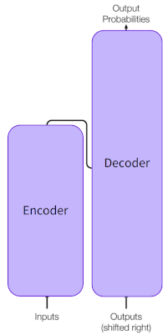
BERT Natural Language Processing
Bidirectional Encoder Representations from Transformers
A Transformer consists of an Encoder and a Decoder
The Encoder preprocesses input to provide word representations(embeddings)
to the Decoder, which creates the outputs

Slide 5
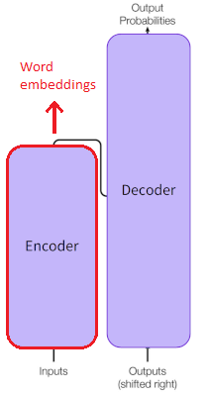
BERT Natural Language Processing
Bidirectional Encoder Representations from Transformers
A Transformer consists of an Encoder and a Decoder
The Encoder preprocesses input to provide word representations(embeddings)
to the Decoder, which creates the outputs
BERT is an Encoder, trained with two different Decoders on two different tasks. It outputs
word embeddings describing the meaning of the input

Slide 6
BERT Natural Language Processing
Bidirectional Encoder Representations from Transformers
A Transformer consists of an Encoder and a Decoder
The Encoder preprocesses input to provide word representations(embeddings)
to the Decoder, which creates the outputs
BERT is an Encoder, trained with two different Decoders on two different tasks. It outputs
word embeddings containing the meaning of the input
Bidirectional means it can look at the context on both sides of a word to learn its meaning

Slide 7
BERT Natural Language Processing
Bidirectional Encoder Representations from Transformers
A Transformer consists of an Encoder and a Decoder
The Encoder preprocesses input to provide word representations(embeddings)
to the Decoder, which creates the outputs
BERT is an Encoder, trained with two different Decoders on two different tasks. It outputs
word embeddings containing the meaning of the input
Bidirectional means it can look at the context on both sides of a word to learn its meaning
“Dang! I’m out fishing and a huge trout just [blank] my line!”

Slide 8
Text Classification with BERT
Add a classification layer on top of BERT Pubmed-Abstract
Needs to be as lightweight as possible
1 layer of 25 nodes → 1 single output node
Other configurations tested:
10 nodes → lower performance
50 nodes → similar performance, longer training time
2 layers of 25 → ,,

Slide 9
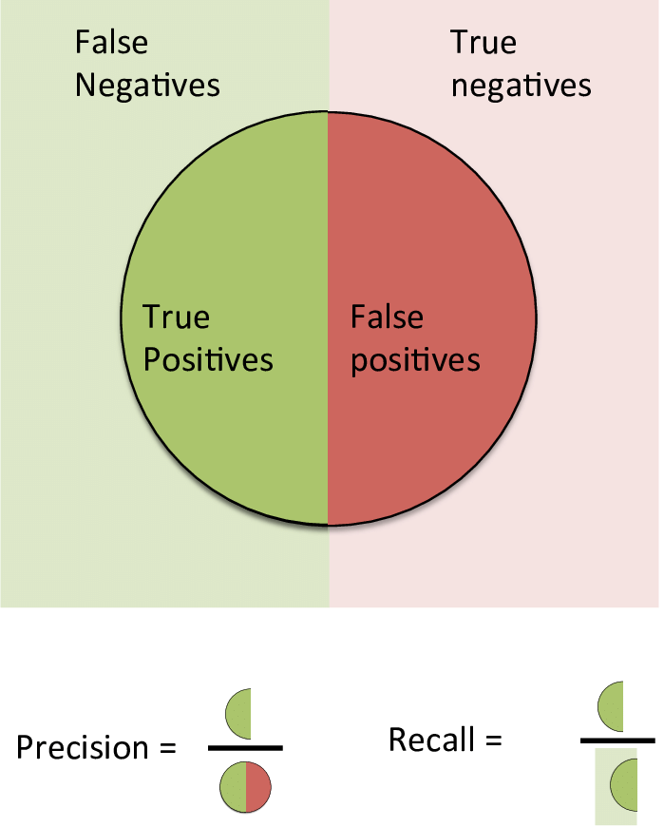
Text Classification with BERT
Added a classification layer on top of BERT Pubmed-Abstract
Trained on ~4500 manually screened papers selected from the original dataset
We don’t want to lose any Included papers → focus on Recall
Goal: at least 95% Recall, with at least 40% Precision

Slide 10
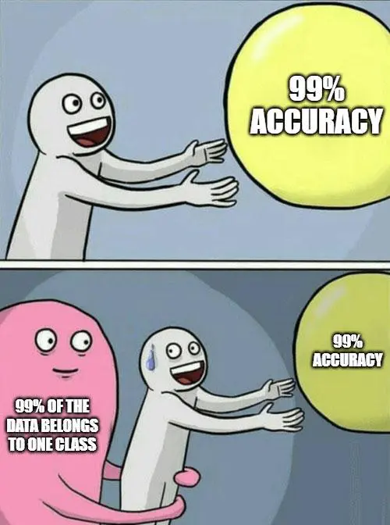
Text Classification with BERT
Added a classification layer on top of BERT Pubmed-Abstract
Trained on ~4500 manually screened papers selected from the original dataset
We don’t want to lose any Included papers → focus on Recall
Goal: at least 95% Recall, with at least 40% Precision
High Recall is difficult because only 10% of the training data is positive

Slide 11
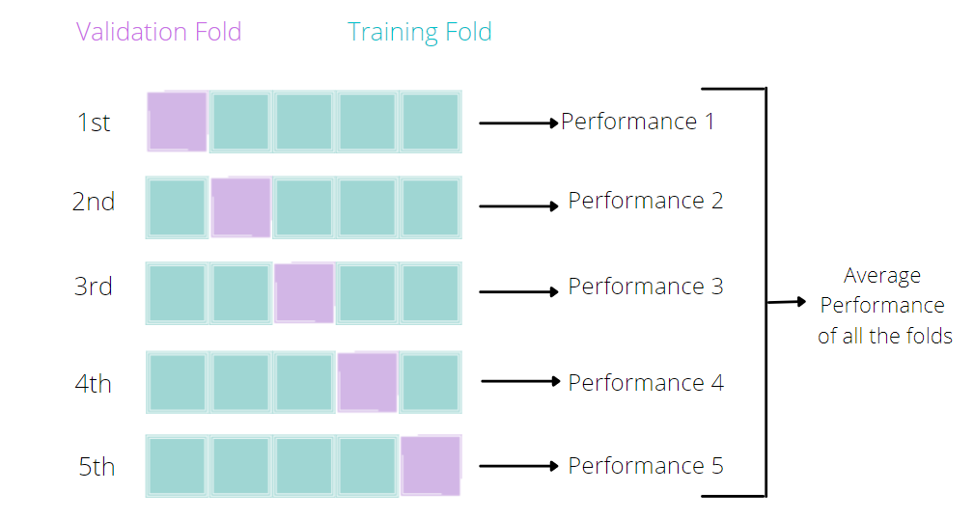
K-fold analysis
‘Rotate’ the Test and Train split to see the performance across the whole dataset
Result:
SD is harder, less consistent than CNS
Possibly because SD has no hard inclusion criteria, only exclusion criteria → broader dataset, which makes it harder to learn
Correct classification is hard to determine because even among trained screeners there is debate

Slide 12
K-fold analysis
‘Rotate’ the Test and Train split to see the performance across the whole dataset
Result:
SD is harder, less consistent than CNS
Possibly because SD has no hard inclusion criteria, only exclusion criteria→ broader dataset, which makes it harder to learn
Correct classification is hard to determine because even among trained screeners there is debate
Papers that required a third screener:
From total training set From “difficult” papers
CNS 7.7% (373/4840) CNS 35.2% (69/196)
SD 13.3% (665/5000) SD 37.1% (145/391)
Ideally difficult papers would be re-examined

Slide 13
Results
SD: 13 228 papers selected from 61 278
CNS: 11 017 papers selected from 53 439
Now:
“Only” 6 638 papers per screener in a team of 10
First another selection round by the Crowd

Slide 14

Key Take-Aways
Documentation and Data Management is really important
Secondary result:
Properly documented GitHub repository

Slide 15
Thanks
İlay Özturk & Linda Hemmann
Anna Fogtman
Fanny Roessler & Giorgio Lorini
The whole STARS team
Everyone in K28 & all the interns
All the EAC staff

